Slide 1
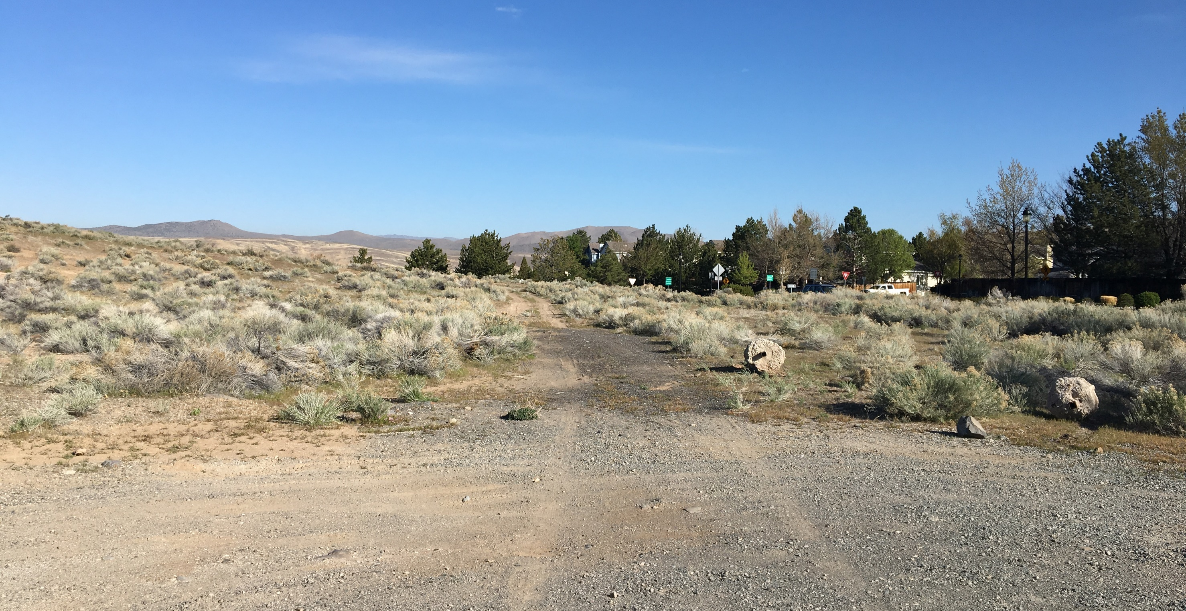
Los Altos Zoning Map Amendment

Slide 2
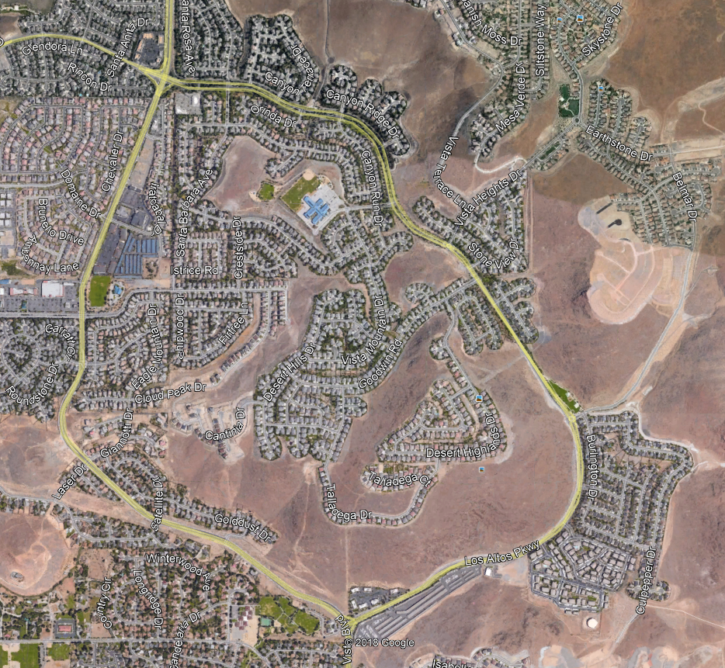
Basis of Legal Guidelines
The Vista’s Planned Development agreement
Vista’s CC&R’s document
The Vistas
A Planned Residential Community

Slide 3
Original Vista’s Approval from 1988
Build-Out of the Vista’s

Slide 4
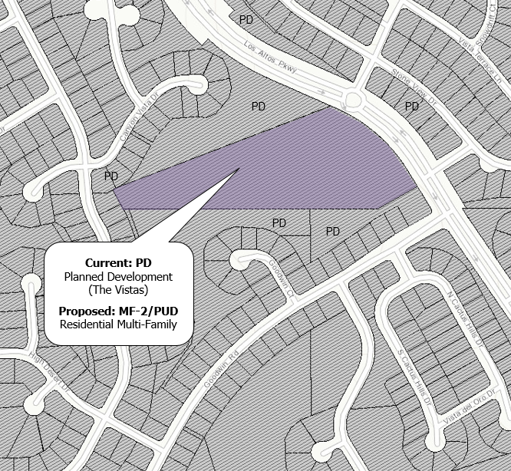
Why is the Zone Change Needed?
Zone Change to MF-2/PUD
Development Agreement
Limits density to 75 units
Limits use to townhomes
Requires 1.5 acres of open space
Includes building design standards

Slide 5
Conceptual Site Plan
Access
Open space buffers
Limited to 75 residential units
Townhome units
Contributes to Vista’s HOA
Open space
Open space
Open space

Slide 6
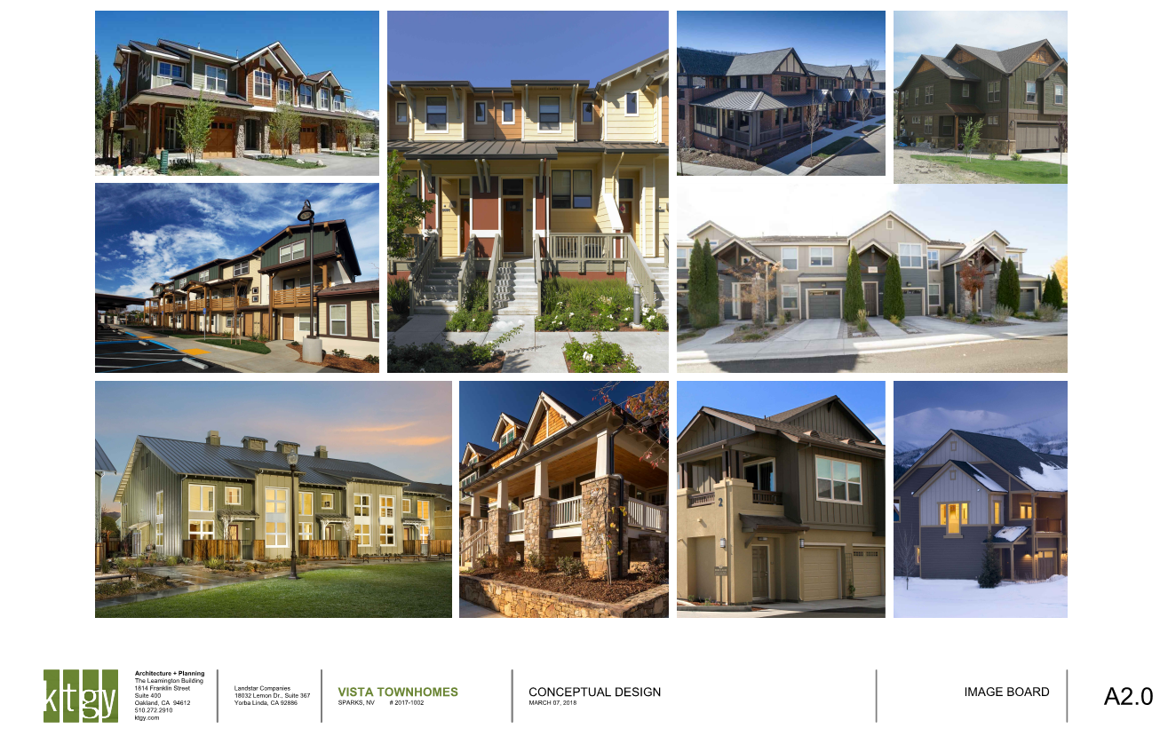
Conceptual Building
Design and Standards
2 stories
Match existing architectural design of the Vista’s
Units average 1,600 SF in size
Anticipated to be priced in the $350,000-$400,000 range
Open space

Slide 7
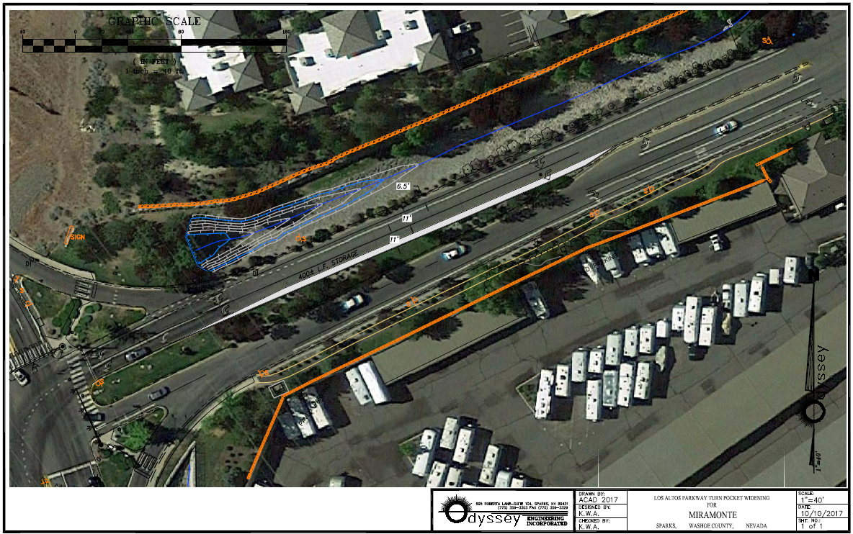
Project will generate only 39 peak hour trips.
Los Altos Parkway will function within policy LOS at full build-out of the community.
Improvement at Los Altos (south)/Vista Blvd is conditioned on prior projects.
Traffic Considerations
Open space

Slide 8
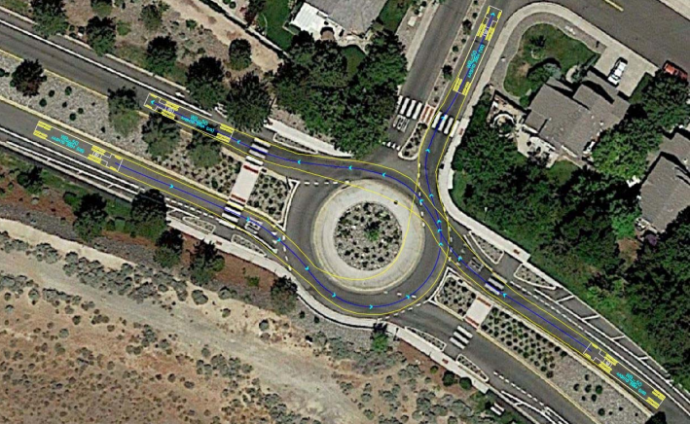
Roundabout Questions
Traffic study based on full build-out of The Vistas and Miramonte
Operates at a Level of Service (LOS) A at build-out
Appropriately sized per national standards
Appropriate 90 degree geometry for a fourth leg
Los Altos/Vista Heights Roundabout
Open space

Slide 9
Additional Requirements if Requested by City Council or at Tentative Map
Agree to 2 car garage minimum with each unit.
Agree to add pedestrian activated flasher at the Los Altos crosswalk at Goodwin Rd, pending City Engineer approval.
Agree to submit an updated traffic analysis at time of tentative map.
Agree to construct the 4th leg at the Vista Heights roundabout in accordance with NCHRP Report 672, per the traffic report recommendations.
Agree to improve the site line to the crosswalk on the north leg of the Vista Heights roundabout, including removal of landscaping.

Slide 10
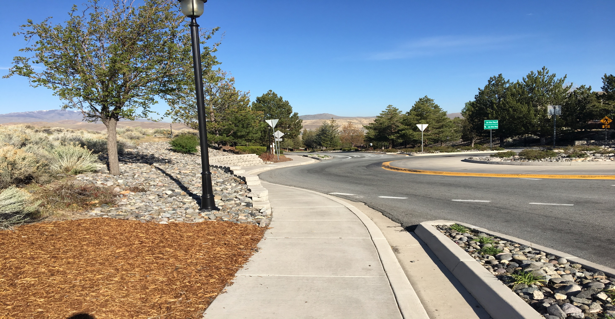
Questions?

